Slide 1
Introduction to python
Lecture 2: Variables and Data Types

Slide 2
Agenda
Understanding the Basic Data Types
Identify data type of an object
Verify if an object is of a certain data type
Coerce object to new data type
Operators and operands
Different types of operators: Arthematic,Assignment, Relational/Comparision, Logical and Bitwise Operators
Precedence of the Operators

Slide 3
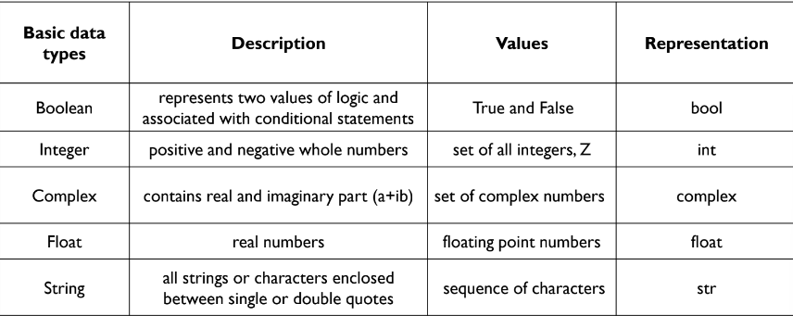
Understanding basic Data Types

Slide 4
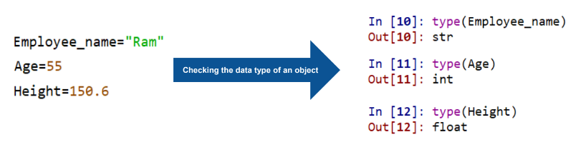
Identifying object data type
Find data type of object using
-> Syntax: type(object)
Example:

Slide 5
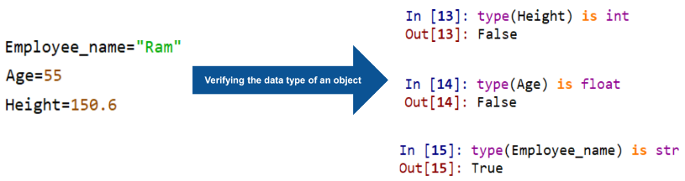
Verifying Object Data Type
Verify if an object is of a certain data type
-> Syntax: type(object) is datatype

Slide 6
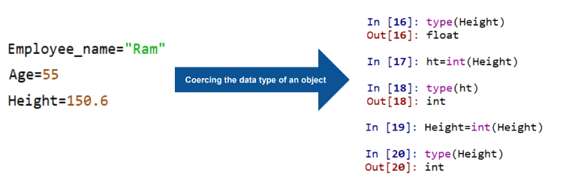
Coercing object to new data type
Convert the data type of an object to another
Syntax: datatype(object)
Changes can be stored in same variable or in different variable

Slide 7
Coercing object to new data type
Only few coercions are accepted
Consider the variable ‘Salary_tier’ which is of string data type
‘Salary_tier’ contains an integer enclosed between single quotes
However if the value enclosed within the quotes is a string then conversions will not be possible

Slide 8
Operators and Operands

Slide 9
Operators and operands
Operators are special symbols that help in carrying out an assignment
operation or arithmetic or logical Computation
Value that the operator operates on is called operand
Example: 2+3 , here + is operator and 2,3 are operators

Slide 10
Arthmetic Operators
Used to perform mathematical operations between two operands
Create two variable a and b with values 10 and 5 respectively
Some of the Arthematic Operators are: +, -, *, /, (), **

Slide 11
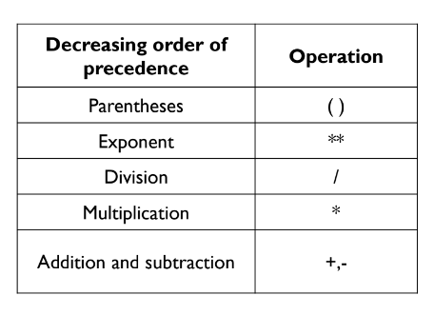
Hierarchy of arithmetic operators

Slide 12
Assignment operators
Used to assign values to variables
Symbol : =
Operation: Assign values from right side operands to left side operand
Example: a=5,b=10

Slide 13
Assignment operators
With +: Adds right operand to left operand and stores
result on left side operand (a=a+b)
Example: a += b that implies a = a+b
Similarly this method is applicable for other arthmetic operators like + - * /

Slide 14
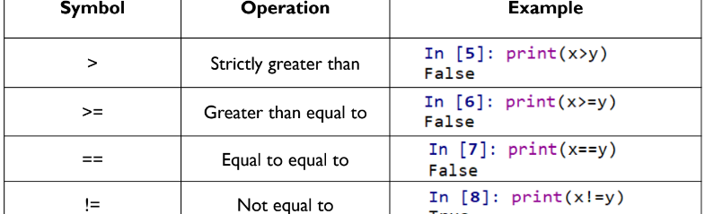
Relational or comparison operators

Slide 15
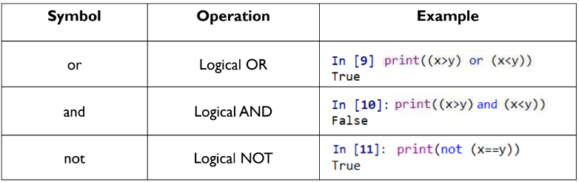
Logical Operators
Used when operands are conditional statements and returns boolean value
In python, logical operators are designed to work with scalars or boolean values

Slide 16
Bitwise Operators
Bitwise operators  Used when operands are integers  Integers are treated as a string of binary digits
Operates bit by bit  Can also operate on conditional statements which compare scalar values or arrays
Bitwise OR (|), AND(&)

Slide 17
Bitwise Operators
Create two variables x and y with values 5 and 7 respectively
Variables: x=5 and y=7
Binary code for 5 is 0000 0101 and for 7 is 0000 0111
0 corresponds to False and 1 corresponds toTrue
In bitwise OR ( | ), operator copies a bit to the result if it exists in either operand
In bitwise AND (& ), operator copies a bit to the result if it exists in both operands

Slide 18
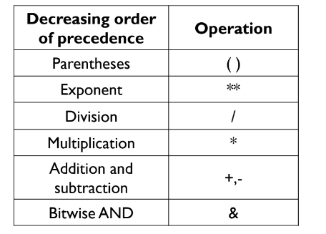
Precedence of operators

Slide 19
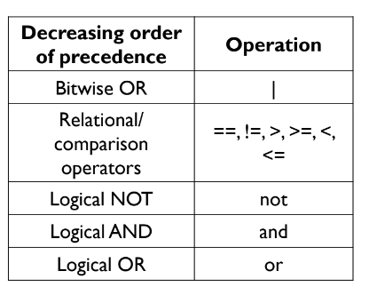
Precedence of operators

Slide 20
Questions
Multiple Choice Question: Which of the following is NOT a primitive data type in Python?
A) int
B) float
C) list
D) bool

Slide 21
True or False: In Python, the data type of a variable is static and cannot be changed once set.
Correct Answer:

Slide 22
Code Analysis: What is the data type of the following variable? x = 7.3
Fill-in-the-Blank: The function type(____) will return the data type of the object enclosed within the parentheses.

Slide 23
True or False: The expression isinstance("Hello", str) returns True.
Correct Answer: True
Multiple Choice Question: Which function can verify if a variable x = 10 is an integer?
A) type(x) == int
B) type(x) == "int"
C) isinstance(x, int)
D) isinstance(x, "int")

Slide 24
Code Completion: Convert the string '123' to an integer.
Expected Answer: int('123')
True or False: Casting a float object to an integer in Python using int() will round the float to the nearest integer.
Correct Answer: False (it truncates towards zero)

Slide 25
Fill-in-the-Blank: In the expression 4 + 5 * 3, the + and * are called _________, and 4, 5, and 3 are called _________.
Expected Answer:

Slide 26
Matching Question: Match the following operators with their type:
Operators: +=, <, &&, ^, ||
Types: Assignment, Relational/Comparison, Logical, Bitwise
Expected Answers:

Slide 27
Multiple Choice Question: In the expression 3 + 4 * 5, what is the result?
A) 35
B) 23
C) 20
D) Not enough information

Slide 28
Application based Questions

Slide 29
1. Simple Calculator
Objective: Build a simple calculator that can perform basic arithmetic operations like addition, subtraction, multiplication, and division.
Features:
Prompt the user to enter two numbers.
Ask the user to choose an operation (+, -, *, /).
Perform the operation and display the result.
Handle basic error conditions, such as division by zero.

Slide 30
2. Personal Budget Planner
Objective: Develop a simple application that helps users manage their monthly budget.
Features:
Allow the user to enter their total monthly income.
Allow the user to enter various expenses such as rent, groceries, utilities, and entertainment.
Calculate the total expenses and the remaining balance after all expenses are accounted for.
Display a summary that shows income, each expense, total expenses, and balance.

